Slide 1

2022 CDBG and Affordable Housing Program Accomplishments
March 21, 2023

Slide 2
Rehab Program Summary
Rehab Coordinator hired May 2022 to re-launch program
  Program was limited to Emergency Rehab from April 2020 to July 2022 due to COVID-19
  General Rehab resumed July 2022
Total Rehab Program Assistance – $141,232 (up from $69,325 in 2021)
  15 households assisted (up from 12 in 2021)
  Average cost – $9,415 ($2,434 increase cost per project over 2021 – 26%)

Slide 3
CDBG Program Accomplishments
Public Service
Boulder County Housing Counseling Program – $50,000
  100% expended
  205 residents assisted
  Leveraged $396,401
Entrepreneurship for All – $30,206
  100% expended
  64 residents assisted
  Leveraged $369,704

Slide 4
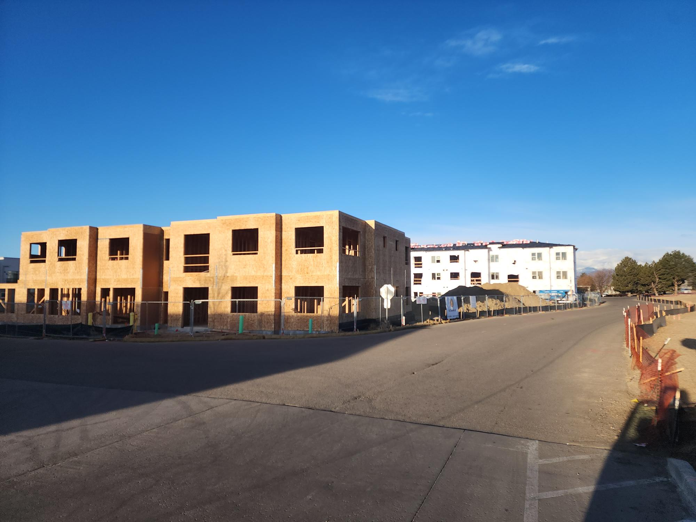
CDBG Program Accomplishments (2)
Grants to Partners
Crisman II Land Acquisition – $402,916
  100% expended
  83 new affordable rental homes created
  Leveraged $30,445,478

Slide 5
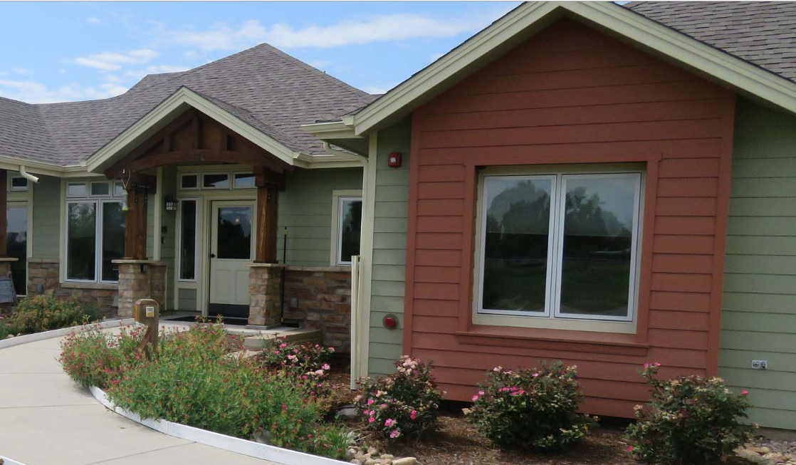
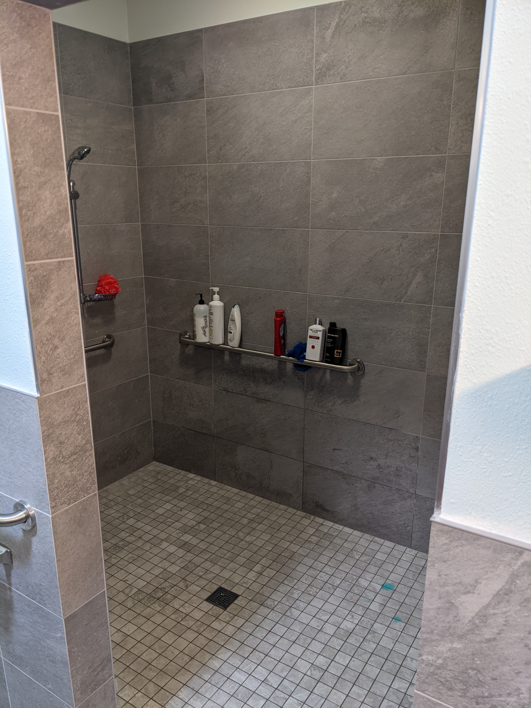

CDBG Program Accomplishments (3)
Grants to Partners
Rehab of Imagine! Group Home – $49,999
  100% expended
  Preserved affordability and made improvements to better serve 6 individuals with intellectual and developmental disabilities
  Leveraged $7,000

Slide 6
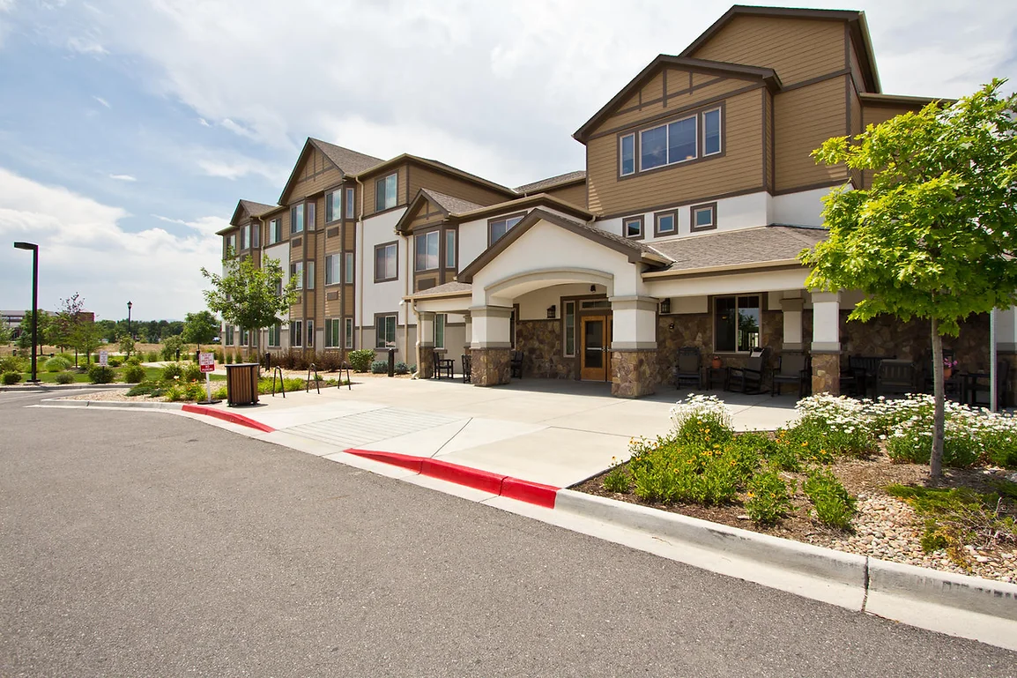
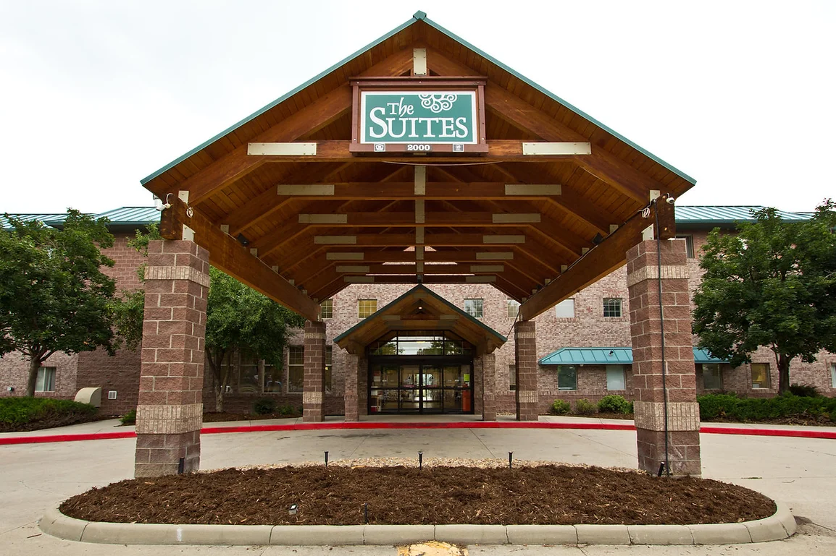
CDBG Program Accomplishments (4)
Grants to the Longmont Housing Authority
LHA Security Cameras – $61,600
  To be complete Spring 2023
  Coordinating with Public Safety for citywide system
Aspen Meadows Neighborhood Playground Replacement – $25,800
  To be complete Spring 2023
Parking Lot Repair and Accessibility Improvements at Hearthstone & Lodge at Hover Crossing – $36,805
  To be complete Spring 2023

Slide 7
CDBG – CV Funding
Fresh Start Utility Billing Assistance
  $241,328 expended (including $89,551 in regular CDBG)
  Supported housing stability and prevented utility shut off for 169 households
  Program will continue through mid-2023

Slide 8
CDBG Program Comparisons
459 households served
65.4% of CDBG funds expended in 2022 (38% in 2021, 60% in 2020)
27.6% of CDBG-CV grant expended in 2022 (44% total complete)
2022 timeliness ratio was 1.30 (1.5 is max) (1.54 in 2021, 1.4 in 2020)
Met HUD timeliness deadline in October 2022 – avoided corrective action
Leveraged >$31M in other funding invested into the community
  $35.11 for every $1 in CDBG funds ($83 in 2021, $14 in 2020)
20% of 2022 funding spent on administration (cap is 20%) (16.4% in 2021, 15.4% in 2020) – Full HCI team in place as of May 2022
99.2% of funding spent in 2022 benefitted low/moderate income residents (73% in 2021, 99.7% in 2020)
Notes:
CV = 50% complete in total

Slide 9
CDBG Program Accomplishments (5)

Slide 10
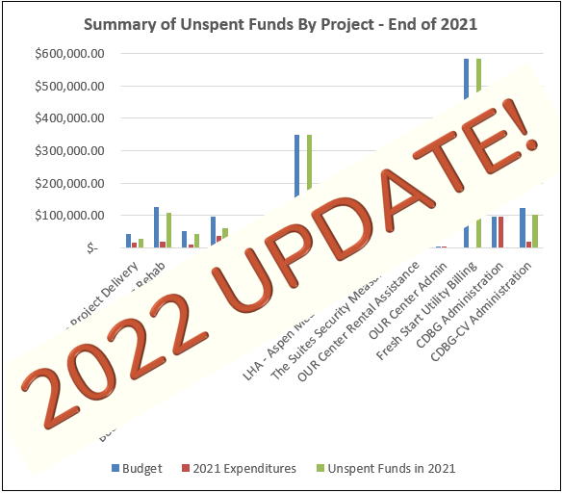
2021: Why CDBG Funds are Unspent
Need to get Rehab funding out into community ($255,052 unspent). $141,232 spent!
Crisman II Acquisition and Imagine! Rehab occurring spring 2022. Both completed in 2022!
Struggle to spend CDBG-CV funds for Rental Assistance due to regulations and other funding sources available. 44% funds spent, up from 22% in 2020-21
Fresh Start Utility Billing Assistance Program launched November 2021- $241,328 spent helping 169 households!
Notes:
Will consider reallocating some Rehab funding if needed into other projects to boost 2022 spending.

Slide 11
Equity and Inclusion
53% of households had incomes below 30% AMI
47% had female head of households
39% identify as Latino/Hispanic
13% were disabled households

Slide 12
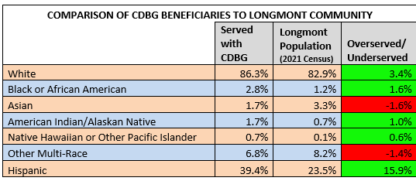
Equity and Inclusion (2)

Slide 13
Affordable Housing Program Accomplishments
City-owned Rehab of Adrian House – $59,750
Large-family housing opportunity with LHA management
  Construction began in Spring 2022
  Total AHF spent to date $184,750
  5 bedroom SF home for future voucher household
Crisman II – $600,000
Pre-Development Costs
  82 new affordable rental homes
  Construction began Summer 2022
Zinnia – $509,212
Pre-Development Loans for Permanent Supportive Housing
  55 new PSH rental units
  Received 9% tax credit award
  Construction to begin June 2023

Slide 14
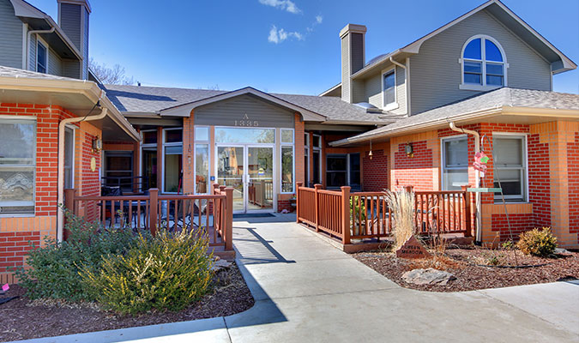
Affordable Housing Program Accomplishments (2)
Fee Offsets provided
  $297,823 for 3 affordable rental developments adding a total of 143 affordable rental apartments in Longmont

Slide 15
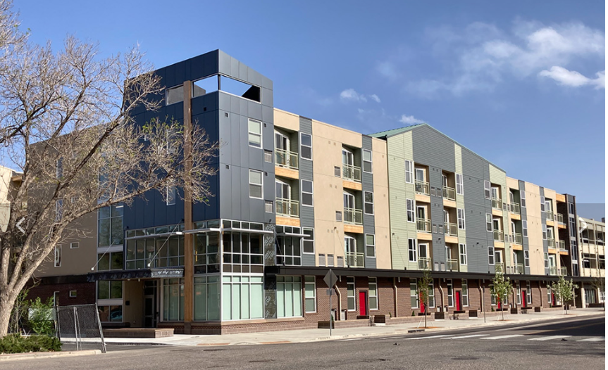
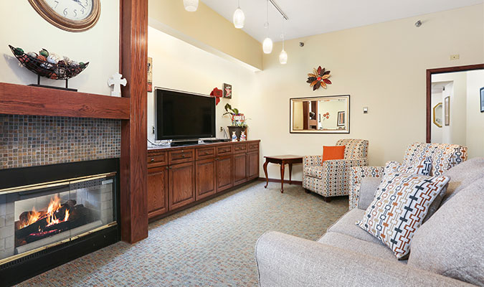
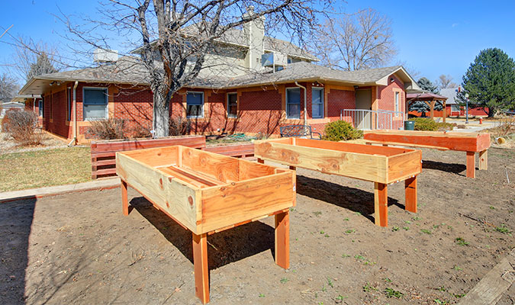
Affordable Housing Program Accomplishments (3)
Fee Offsets
Payments made in 2022
BCHA The Spoke – $90,538
Longmont Family Apartments – $151,518
Cinnamon Park Senior Housing – $55,767

Slide 16
Affordable Housing Program – Pending
Habitat for Humanity – Rogers Road Infrastructure – $646,717
Infrastructure Loan
  Expenditure in early 2023
  9 for-sale affordable units to be built
Mustang Land Purchase – $300,000 per year for 5 years
Infrastructure improvements on 9 City-owned acres for affordable housing
  Leverages $1.5M in ARPA funds used to acquire property
  Working on potential development concepts for affordable for-sale homes
Fee Offsets scheduled for 2023
Mountain Brook (Habitat for Humanity) – $30,519
Crisman II – $147,624

Slide 17
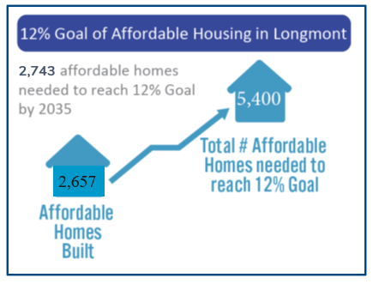
Affordable Housing Program Accomplishments (4)
Administration
Conducted 2 application cycles in 2022 with 11 total applications reviewed and 2 projects approved for AH funding (+5 CDBG)
Fee-In-Lieu of 12% affordable housing built collected in 2022- $469,294 (program started 2018- initial developments finally to CO)
Neighborly Grant Management Program implemented

Slide 18

Affordable Housing Program Accomplishments (5)
Continued participation in Regional AH Partnership
  Negotiated IGA to support small Boulder County municipalities with IH compliance
  Boulder County hired Housing Partnership & Policy Manager to support the work of the partnership
  Coordinated ARPA proposals for affordable housing
Administration

Slide 19
Public Hearing
Questions?
Please hold public hearing.
Consider approval of submission of CAPER to HUD.
Any additional public comments received (open until March 27th, 2023) will be included in the CAPER document and the final document will be posted on the City’s website.

Slide 20

THANK YOU

